Slide 1
SMART HEALTHCARE
GUIDE:
PROF.SHOLA USHA RANI.
SUBMITTED BY:
G.PAVAN KUMAR
16MIS1097

Slide 2
PROBLEM DEFINITION:
Even with the latest tech-advancements the “Lack of Information and Clinical Decision Making” are becoming difficult to health caretakers as the patient information management has become a hectic job.

Slide 3
MOTIVATION:
The background idea of the system discussed here is to serve as a ubiquitous platform for all the healthcare services, especially shifting the treatments to remote and virtual paradigms, thanks to IoT, decision support systems and predictive analytics.

Slide 4
OBJECTIVES:
Improved health of the mass.
Lowered cost of high-quality healthcare.
Improved experience for patient and medical personnel.
Best use of resources.
Ambient assisted living

Slide 5
SCOPE:
Scope of IoT-based Smart healthcare is empowering the physicians with deeper level of insights into patient’s data, therefore enabling them to devise a tailored and efficient treatment.

Slide 6
LITERATURE SURVEY:
In India, a survey[1] was conducted to observe the functioning of different medical centers and the improvement in healthcare the survey revealed that patient records in many of the hospitals were not managed properly, also the patient referrals(OP) among various hospitals were based on paper documents.
As facilities were not available to precisely estimate patient’s history, the healthcare quality was inefﬁcient. The survey revealed that healthcare facilities can be improved with the help of Information Technology, mainly using Electronic Health Records (EHRs).

Slide 7
REQUIREMENT SPECIFICATIONS:
Functional:
Accessibility, Capability and forecast, Efficiency, Disaster Recovery, Documentation etc.
Non-Functional:
System Administrator, End User, User Satisfaction.

Slide 8
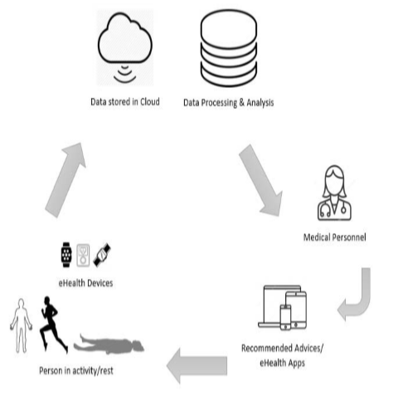
Architectural Design:

Slide 9
HARDWARE AND SOFTWARE REQUIREMENTS:
HARDWARE: Intel Galileo Generation 2, XB24-B XBee S2 Modules, Xbee Adapter, LM35 Temperature Sensor etc.
SOFTWARE: Security and Support, Database, Data Sets etc.

Slide 10
REFERENCES:
[1] Koppar, Anant R, and Venugopalachar Sridhar, “A workﬂow solution for electronic health records to improve healthcare delivery efﬁciency in rural India,” In eHealth, Telemedicine, and Social Medicine, 2009. eTELEMED’09. International Conference on, pp. 227–232, IEEE, 2009.
P. Chatterjee and R. L. Armentano, "Internet of Things for a Smart and Ubiquitous eHealth System," 2015 International Conference on Computational Intelligence and Communication Networks (CICN), Jabalpur, 2015, pp. 903-907. doi: 10.1109/CICN.2015.178
L. J. Cymberknop, P. Chatterjee, D. Dujovne, L. Romero, and R. L. Armentano, “Internet of Things toward Efficient Analysis of Aging, Cardiometabolic, and Neurodegenerative Diseases—An E-Health Perspective”, The Internet of Things: Foundation for Smart Cities, eHealth and Ubiquitous Computing, CRC Press (Taylor & Francis), 2017, ISBN: 9781498789028

